Slide 1
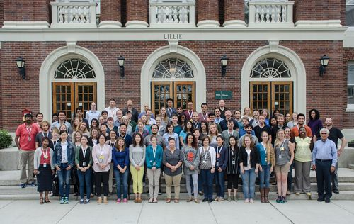
Welcome to STAMPS!
#STAMPS2018

Slide 2
About STAMPS
Learning goals
Course format
Code of Conduct
Course materials
Communication channels
Introductions

Slide 3
Learning goals Strategies and Techniques for Analyzing Microbial Population Structure
Foundational skills to work with metagenomic data
How to work effectively and reproducibly with data
Familiarity and practice with particular bioinformatics tools
Ability to learn about and evaluate other tools and understand caveats
Perspective and confidence to apply these skills in your own work
Empower you to ask and answer the questions you have of your own data
Building a framework and a network

Slide 4
Course format
Hands-on, active learning
Materials available during and after the course
Mix of lectures, tutorials and practice in projects
Ask questions!
Feedback and formative assessment
Learn from each other as well as instructors and Tas
Learn by teaching

Slide 5
Code of Conduct
STAMPS Code of Conduct
All STAMPS attendees are expected to agree with the following code of conduct. We will enforce this code as needed. We expect cooperation from all attendees to help ensuring a safe environment for everybody. MBL also has a formal Code of Conduct.
The Quick Version
STAMPS events are neither a dating scene nor an intellectual contest.
STAMPS is dedicated to providing a harassment-free experience for everyone, regardless of gender, gender identity and expression, age, sexual orientation, disability, physical appearance, body size, race, or religion (or lack thereof). We do not tolerate harassment of participants in any form. Sexual language and imagery is generally not appropriate for any STAMPS venue.
If you are being harassed, notice that someone else is being harassed, or have any other concerns, please contact Tracy Teal or Mihai Pop immediately. If either is the cause of your concern, please see the MBL’s Equal Employment Opportunity Coordinator at 508-289-7378 or eeo@mbl.edu.
https://github.com/mblstamps/stamps2018/wiki/Code-of-Conduct

Slide 6
Course materials and schedule
https://github.com/mblstamps/stamps2018/wiki

Slide 7
Communication channels
Email list (announcements)
Collaborative note taking document
Slack (announcements, links and conversations)
https://stamps2018.slack.com/
Twitter #stamps2018

Slide 8
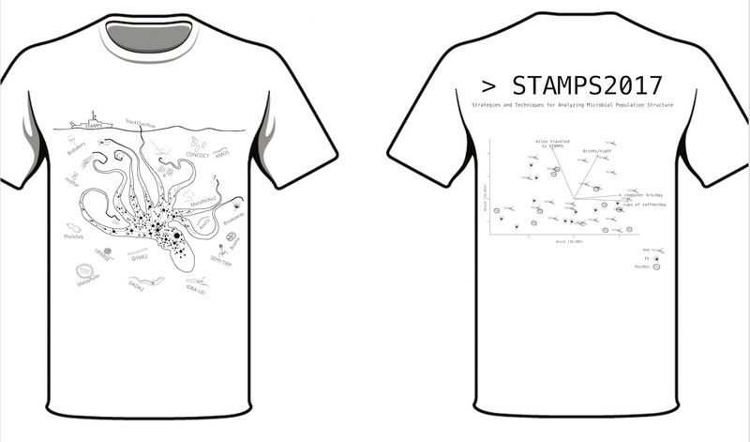
T-shirt

Slide 9
Introductions
Introducing the instructors and TAs
Students introducing themselves

Slide 10
Introductions
Think – Pair
What motivated you to attend STAMPS?

Slide 11
Let’s get started!

Slide 12
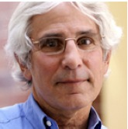
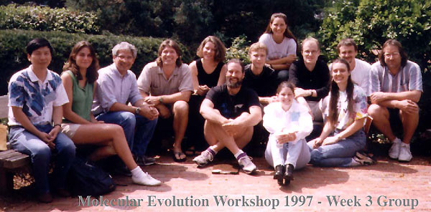
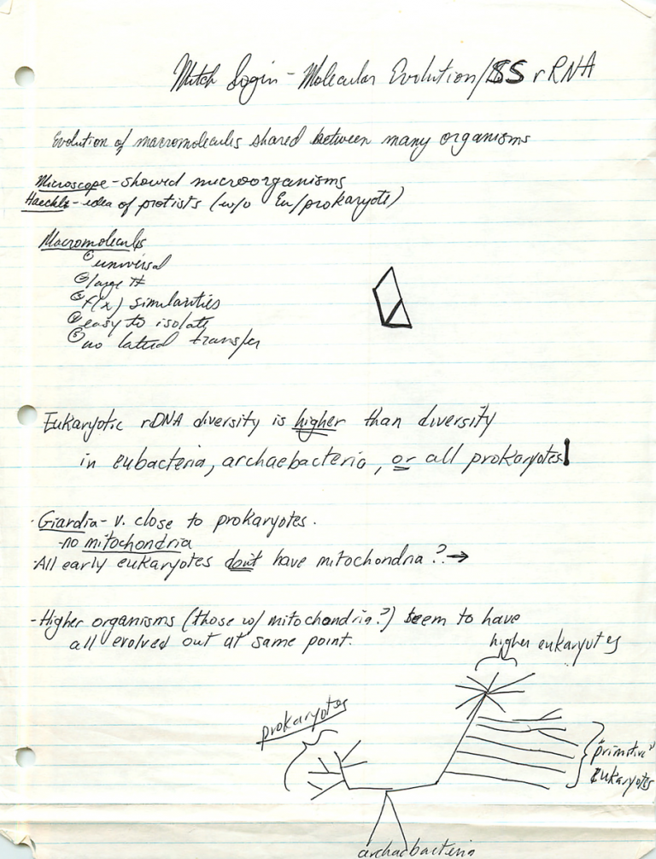
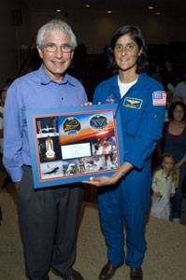
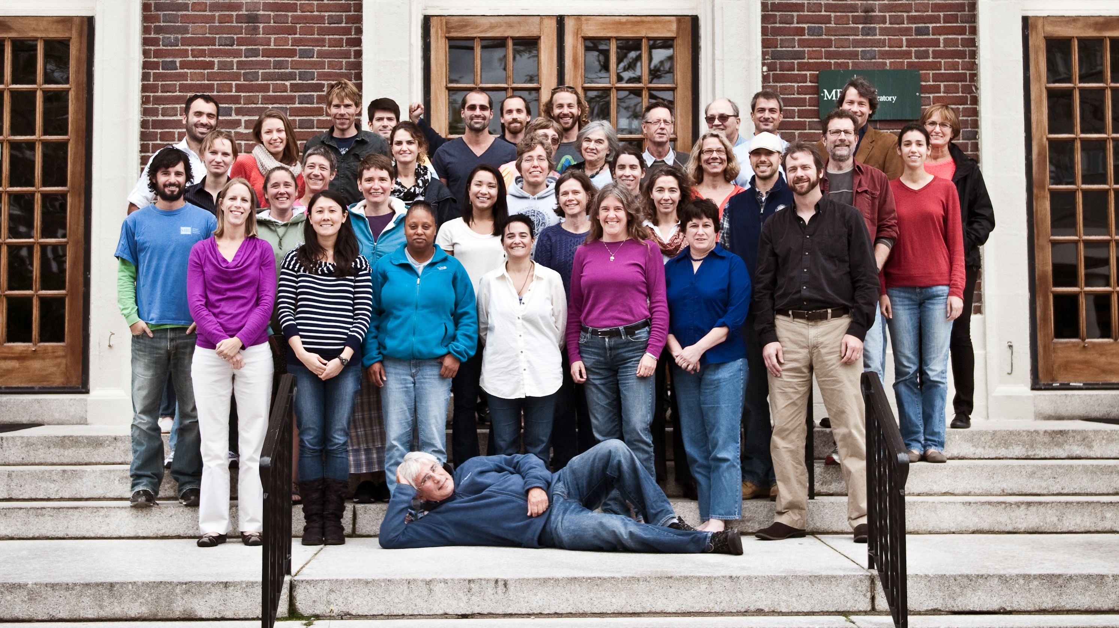
Introducing Dr. Mitch Sogin

